Slide 1




Deadlock

Slide 2
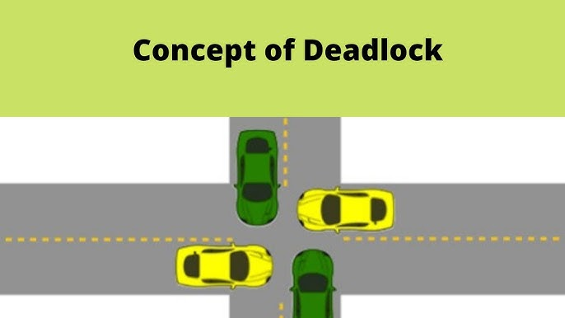

Slide 3

Deadlock
Deadlock is a situation where a set of processes are blocked because each process is holding a resource and waiting for another resource acquired by some other process.
Or
A deadlock is a situation in which more than one process is blocked because it is holding a resource and also requires some resource that is acquired by some other process. Therefore, none of the processes gets executed.

Slide 4
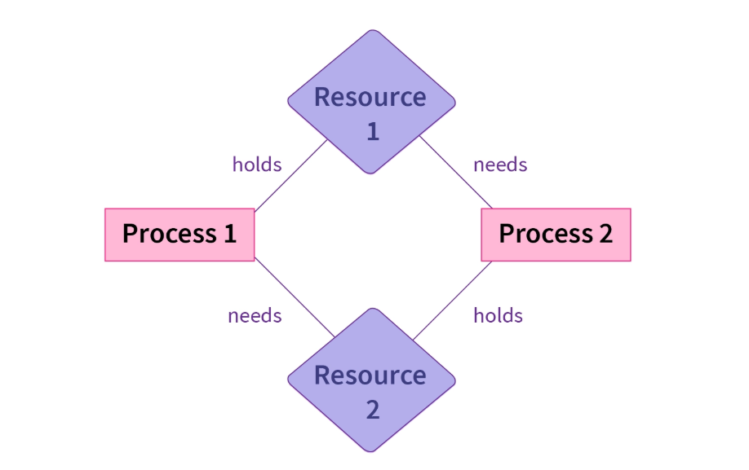

Slide 5
Deadlock
System consists of a finite number of resources to be distributed among a number of competing processes.
The resources are partitioned into several types, each of which consists of some number of identical instances.
Memory space, CPU cycles, files, and I/O devices (such as printers) are examples of resource types.

Slide 6
Deadlock
Under the normal mode of operation, a process may utilize a resource in only the following sequence:
Request: If the request cannot be granted immediately (for example, the resource is being used by another process), then the requesting process must wait until it can acquire the resource.
Use: The process can operate on the resource (for example, if the resource is a printer, the process can print on the printer).
Release: The process releases the resource.

Slide 7
Deadlock Characterization
In a deadlock, processes never finish executing and system resources are tied up, preventing other jobs from starting.
Necessary Conditions A deadlock situation can arise if the following four conditions hold simultaneously in a system: 1. Mutual exclusion: At least one resource must be held in a non-shareable mode; that is, only one process at a time can use the resource. If another process requests that resource, the requesting process must be delayed until the resource has been released. 2. Hold and wait: A process must be holding at least one resource and waiting to acquire additional resources that are currently being held by other processes.

Slide 8
Deadlock Characterization
3. No pre-emption: Resources cannot be preempted; that is, a resource can be released only voluntarily by the process holding it, after that process has completed its task. 4. Circular wait: A set {P0, P1, ..., Pn) of waiting processes must exist such that P0 is waiting for a resource that is held by P1, P1 is waiting for a resource that is held by P2, and finally Pn is waiting for a resource that is held by P0. This creates a circular relation between all these processes and they have to wait forever to be executed.

Slide 9
Resource-Allocation Graph
Deadlocks can be described more precisely in terms of a directed graph called a system resource-allocation graph. This graph consists of a set of vertices V and a set of edges E
The set of vertices V is partitioned into two different types of nodes
P = {PI, P2, ..., Pn}, the set consisting of all the active processes in the system, and R = {R1, R2, ..., Rm), the set consisting of all resource types in the system.
A directed edge Pi Rj is called a request edge; a directed edge Pi Rj is called an assignment edge.
Pictorially, we represent each process Pi as a circle, and each resource Ri as square

Slide 10
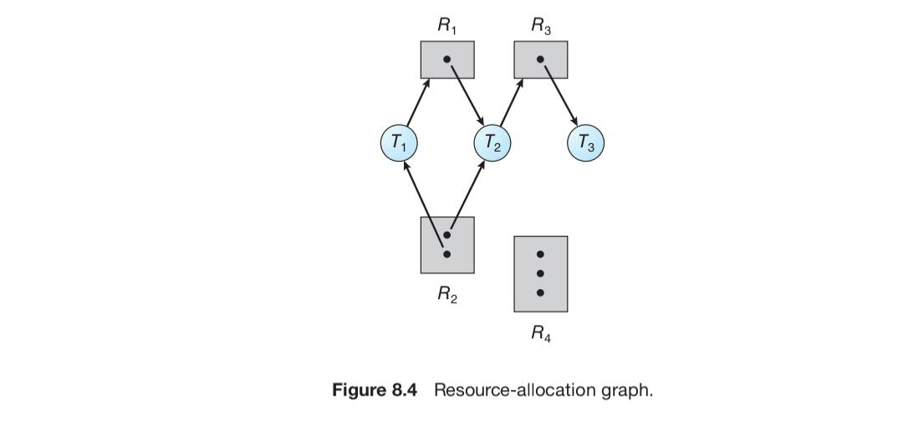
Resource-Allocation Graph

Slide 11
Resource-Allocation Graph
The sets T, R, and E: ◦ T = {T1, T2, T3} ◦ R = {R1, R2, R3, R4}
{T1 → R1, T2 → R3, R1 → T2, R2 → T2, R2 → T1, R3 → T3}
• Resource instances:
◦ One instance of resource type R1
◦ Two instances of resource type R2
◦ One instance of resource type R3
◦ Three instances of resource type R4
• Process states:
◦ T1 is holding an instance of resource type R2 and is waiting for an instance of resource type R1.
◦ T2 is holding an instance of R1 and an instance of R2 and is waiting for an instance of R3.
◦ T3 is holding an instance of R3.

Slide 12
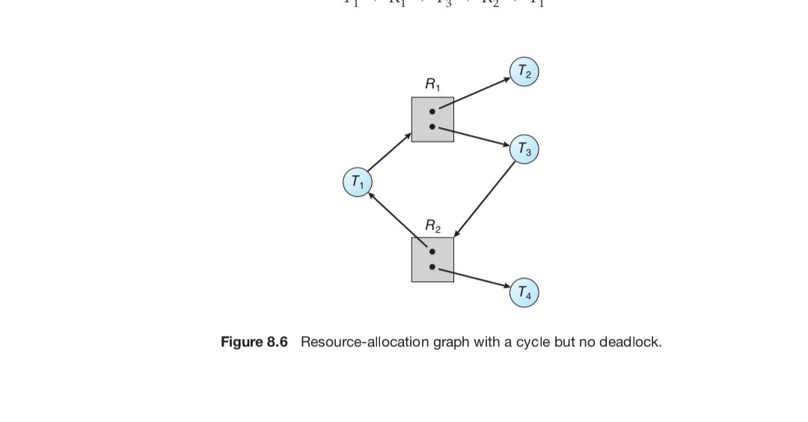
Resource-Allocation Graph

Slide 13
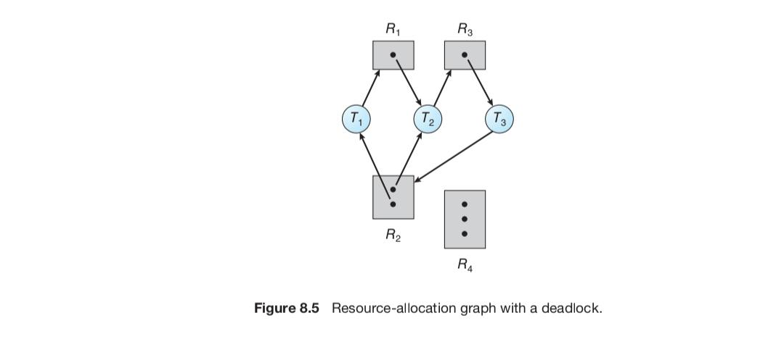
Resource-Allocation Graph
if a resource-allocation graph does not have a cycle, then the system is not in a deadlocked state. If there is a cycle, then the system may or may not be in a deadlocked state

Slide 14
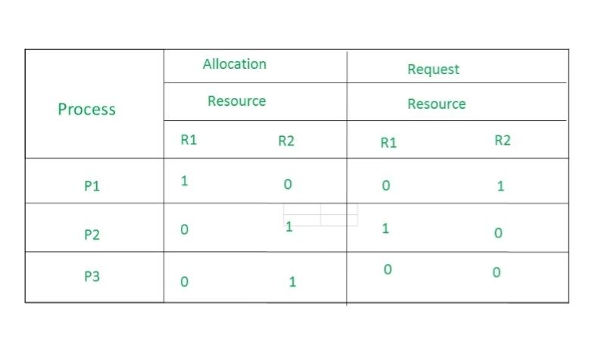
Find Resource Allocation Graph

Slide 15
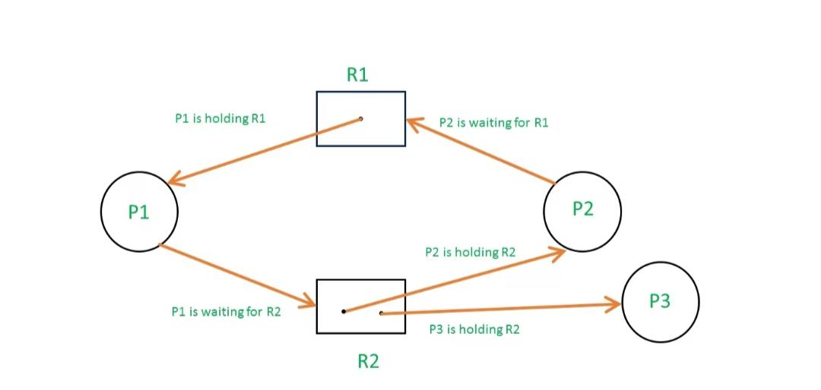
Does this graph produce deadlock?
This graph has cycle but doesn’t produce deadlock

Slide 16
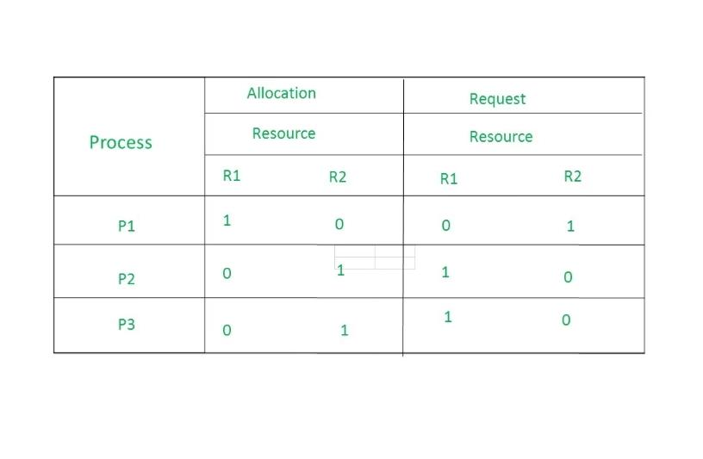
Find Resource Allocation Graph

Slide 17
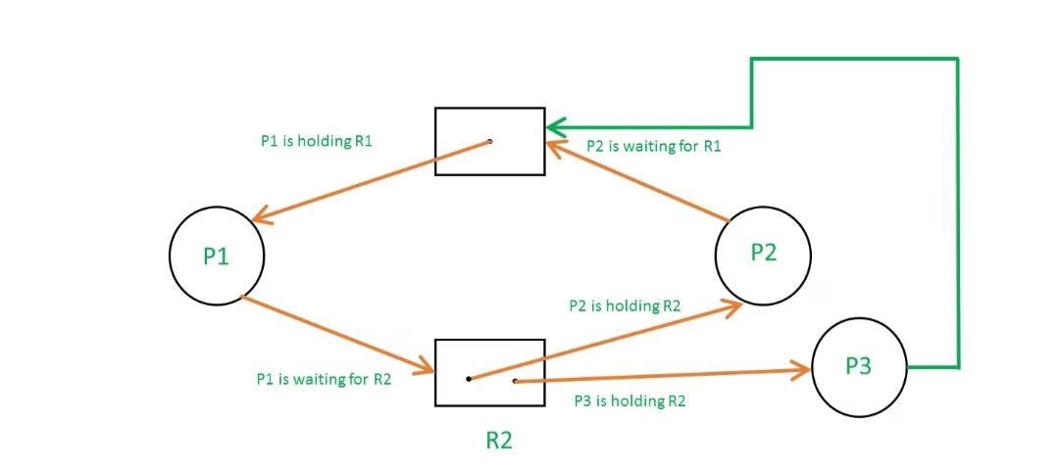
Does this graph produce deadlock?
Deadlock

Slide 18
Methods for Handling Deadlocks
To ensure that deadlocks never occur, the system can use either a deadlock prevention or a deadlock-avoidance scheme.
Deadlock prevention provides a set of methods to ensure that at least one of the necessary conditions cannot hold. These methods prevent deadlocks by constraining how requests for resources can be made.
Deadlock avoidance requires that the operating system be given additional information in advance concerning which resources a process will request and use during its lifetime.
With this additional knowledge, the operating system can decide for each request whether or not the process should wait.
To decide whether the current request can be satisfied or must be delayed, the system must consider the resources currently available, the resources currently allocated to each process, and the future requests and releases of each process.

Slide 19
Deadlock Prevention
1. Eliminating Mutual Exclusion
How it works: Processes cannot have exclusive access to non-sharable resources.
Application: For some resources, like shared read-only files, this is possible. However, for non-sharable resources like printers, this condition is difficult to break.
2. Eliminating Hold and Wait
How it works: A process must request and be granted all its required resources upfront, or it must release all held resources before requesting new ones.
Application:
Request all at once: A process requests all its needed resources before it starts.
Release held resources: A process must release all its currently held resources before requesting new ones.

Slide 20
Eliminating hold and wait
Request All Resources at Once
How it works: Before a process begins its execution, it requests all the resources it anticipates needing for its entire task.
Benefit: If a process doesn't get all its required resources upfront, it waits without holding any resources, thereby eliminating the hold and wait condition.
Drawback: This is often impractical in real computer systems because processes cannot predict all future resource needs. It can also lead to low device utilization because resources are allocated but may remain idle.
Release Resources Before Requesting
How it works: A process must release all resources it currently holds before it makes a request for any new resources.
Benefit: This directly prevents a process from holding some resources while waiting for others, breaking the hold and wait cycle.
Drawback: This approach can lead to starvation, where a process needing multiple resources might have to wait for a very long time because it keeps releasing and re-requesting resources, as at least one needed resource is always in use by another process.

Slide 21
Deadlock Prevention
3. Eliminating No Preemption
How it works: If a process holds resources and needs more that cannot be immediately allocated, the OS can forcibly take back (preempt) the resources it already holds.
Application: This allows the operating system to reallocate resources to other processes and avoid a process holding resources indefinitely.
4. Eliminating Circular Wait
How it works: A total ordering is imposed on all resources, and processes must request resources in a strictly increasing or decreasing order.
Application: Each resource is assigned a unique number (a priority). A process can only request a resource with a higher number than the resource it currently holds. If it needs a resource with low priority, it should release the currently high priority resource.

Slide 22
Deadlock Avoidance
Requires that the system has some priori information available
Simplest and most useful model requires that each process declare the maximum number of resources of each type that it may need
The deadlock-avoidance algorithm dynamically examines the resource-allocation state to ensure that there can never be a circular-wait condition
Resource-allocation state is defined by the number of available and allocated resources, and the maximum demands of the processes

Slide 23
Basic facts
If a system is in safe state ⇒ no deadlocks
If a system is in unsafe state ⇒ possibility of deadlock
Avoidance ⇒ ensure that a system will never enter an unsafe state.

Slide 24
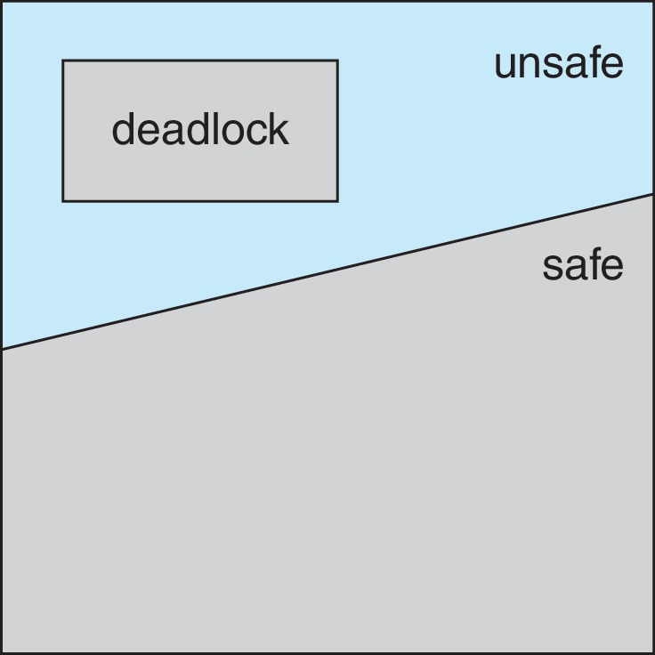
Safe, unsafe, deadlocked state

Slide 25
Basic facts
Single instance of a resource type
Use a resource-allocation graph
Multiple instances of a resource type
Use the Banker’s Algorithm

Slide 26
Deadlock Avoidance-Bankers Algorithm
Banker’s algorithm is a resource allocation and deadlock avoidance algorithm that tests for safety by simulating the allocation for the predetermined maximum possible amounts of all resources.
Helps the OS to successfully share the resources between all the processes. It is called the banker’s algorithm because bankers need a similar algorithm to allocate loans to customers

Slide 27
Data structures for Bankers algorithm
Let n = number of processes, and m = number of resources types.
Available: Vector of length m. If available [j] = k, there are k instances of resource type R_{j} available
Max: n x m matrix. If Max [i,j] = k, then process T_{i} may request at most k instances of resource type R_{j}
Allocation: n x m matrix. If Allocation[i,j] = k then T_{i} is currently allocated k instances of R_{j}
Need: n x m matrix. If Need[i,j] = k, then T_{i} may need k more instances of R_{j} to complete its task
Need [i,j] = Max[i,j] – Allocation [i,j]

Slide 28
Safety Algorithm
Let Work and Finish be vectors of length m and n, respectively. Initialize:
Work = Available
Finish [i] = false for i = 0, 1, …, n- 1
Find an i such that both:
(a) Finish [i] = false
(b) Need_{i} ≤ Work
If no such i exists, go to step 4
Work = Work + Allocation_{i} Finish[i] = true go to step 2
If Finish [i] == true for all i, then the system is in a safe state

Slide 29
Resource-Request Algorithm for Process P_{i}
Request_{i} = request vector for process T_{i}. If Request_{i} [j] = k then process T_{i} wants k instances of resource type R_{j}
If Request_{i} ≤ Need_{i} go to step 2. Otherwise, raise error condition, since process has exceeded its maximum claim
If Request_{i} ≤ Available, go to step 3. Otherwise T_{i} must wait, since resources are not available
Pretend to allocate requested resources to T_{i} by modifying the state as follows:
Available = Available – Request_{i};
Allocation_{i} = Allocation_{i} + Request_{i};
Need_{i} = Need_{i} – Request_{i};
If safe ⇒ the resources are allocated to T_{i}
If unsafe ⇒ T_{i} must wait, and the old resource-allocation state is restored

Slide 30
Example of Bankers Algorithm
5 process T₀ through T₄;
3 resource types:
A (10 instances), B (5instances), and C (7 instances)
Snapshot at time t₀:
Allocation Max Available
A B C A B C A B C
T₀ 0 1 0 7 5 3 3 3 2
T₁ 2 0 0 3 2 2
T₂ 3 0 2 9 0 2
T₃ 2 1 1 2 2 2
T₄ 0 0 2 4 3 3

Slide 31
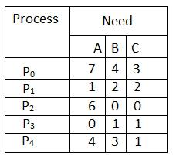
What will be the content of the Need matrix?
The content of the matrix Need is defined to be Max – Allocation Need [i, j] = Max [i, j] – Allocation [i, j]

Slide 32
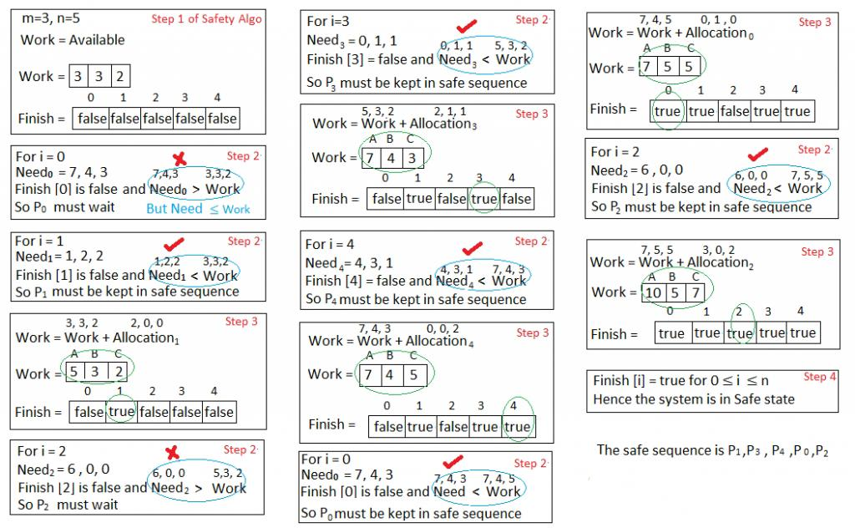
Is the system in a safe state? If Yes, then what is the safe sequence?

Slide 33
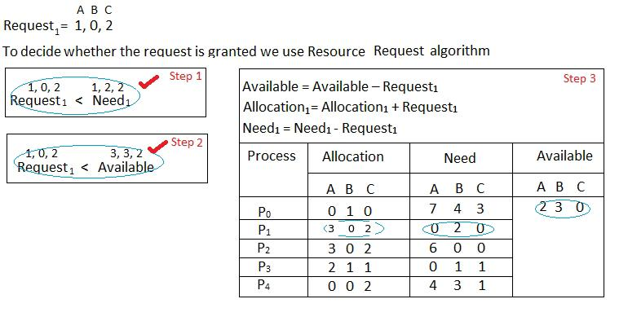
What will happen if process P₁ requests one additional instance of resource type A and two instances of resource type C?: P₁ Request (1,0,2)

Slide 34
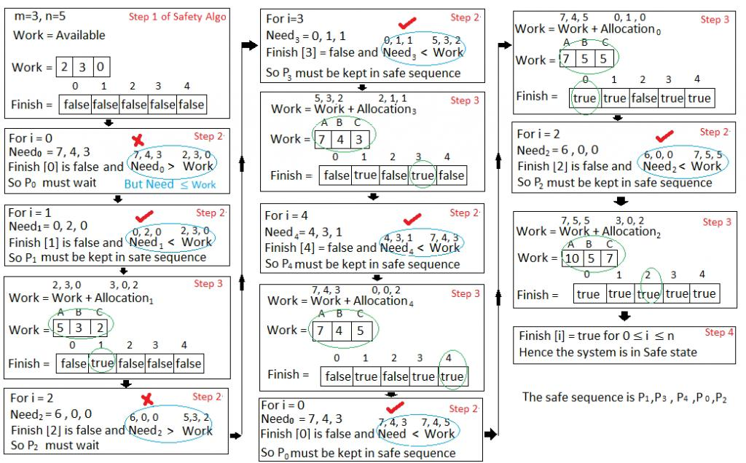
We must determine whether this new system state is safe. To do so, we again execute Safety algorithm

Slide 35
Deadlock Detection
1)Single Instance of Each Resource Type
If all resources have only a single instance, then we can define a deadlock detection algorithm that uses a variant of the resource allocation graph, called a wait-for graph.
We obtain this graph from the resource-allocation graph by removing the resource nodes and collapsing the appropriate edges.

Slide 36
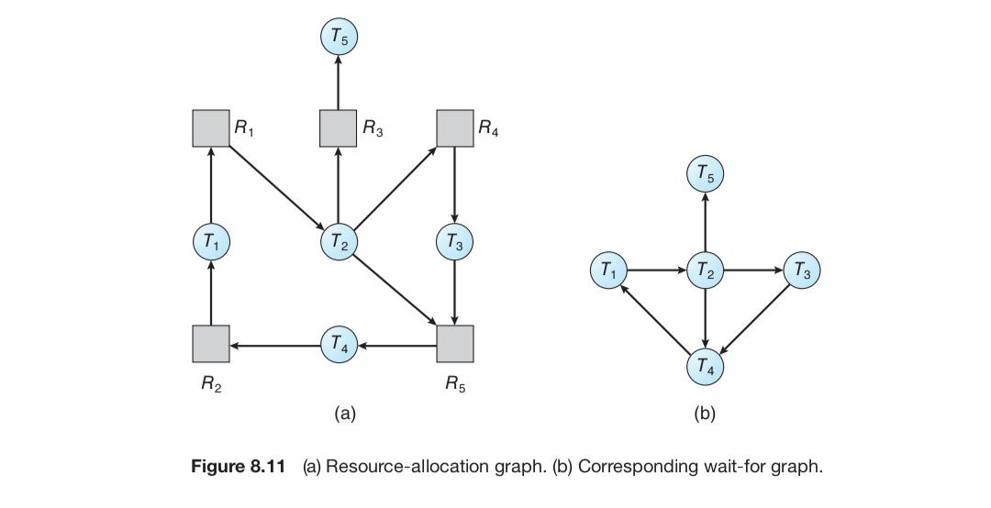
Deadlock Detection

Slide 37
Deadlock Detection
an edge from Ti to Tj in a wait-for graph implies that process Ti is waiting for Tj to release a resource that Ti needs.
An edge Ti → Tj exists in a wait-for graph if and only if the corresponding resource-allocation graph contains two edges Ti → Rq and Rq → Tj for some resource Rq.

Slide 38
Deadlock Detection
A deadlock exists in the system if and only if the wait-for graph contains a cycle.
To detect deadlocks, the system needs to maintain the wait-for graph and periodically invoke an algorithm that searches for a cycle in the graph.

Slide 39
Deadlock Detection
2)Several Instances of a Resource Type
Available. A vector of length m indicates the number of available resources of each type
Allocation. An n × m matrix defines the number of resources of each type currently allocated to each process
Request. An n × m matrix indicates the current request of each process. If Request[i][j] equals k, then Ti is requesting k instances of resource type Rj

Slide 40
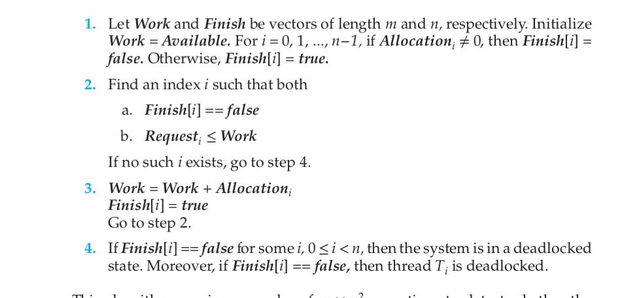
Deadlock Detection

Slide 41
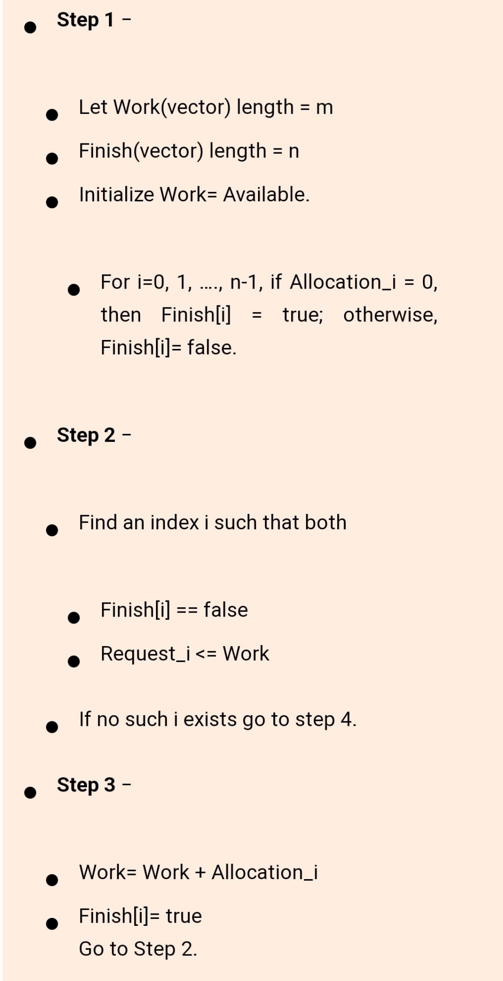
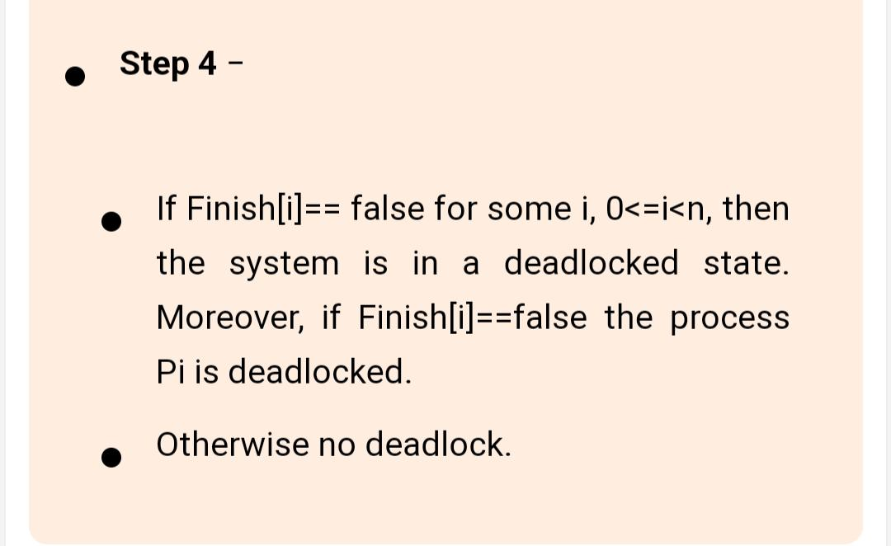
Deadlock Detection

Slide 42
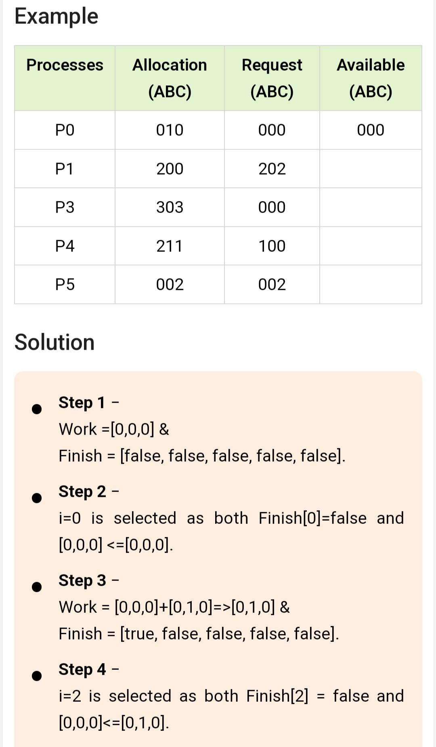
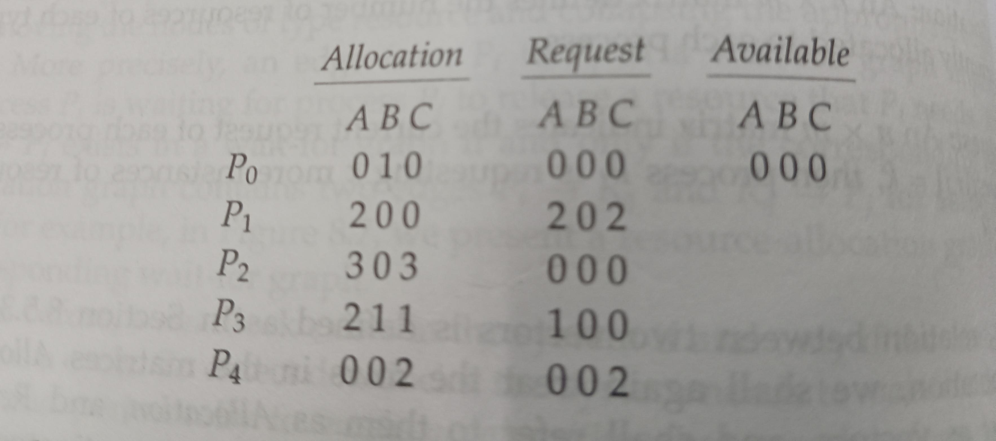
Deadlock Detection
A has 7 instances, B has 2instances, C has 6 instances

Slide 43
Deadlock Recovery
When a detection algorithm determines that a deadlock exists, several alternatives exist.
Process Termination
To eliminate deadlocks by aborting a process, we use one of two methods.
a) Abort all deadlocked processes: This method clearly will break the deadlock cycle, but at a great expense; these processes may have computed for a long time, and the results of these partial computations must be discarded and probably recomputed later

Slide 44
Deadlock Recovery
b) Abort one process at a time until the deadlock cycle is eliminated: This method incurs considerable overhead, since, after each process is aborted, a deadlock-detection algorithm must be invoked to determine whether any processes are still deadlocked

Slide 45
Deadlock Recovery
2) Resource Pre-emption
To eliminate deadlocks using resource pre-emption, we successively pre-empt some resources from processes and give these resources to other processes until the deadlock cycle is broken
If pre-emption is required to deal with deadlocks, then three issues need to address 1. Selecting a victim: Which resources and which processes are to be preempted?
As in process termination, we must determine the order of pre-emption to minimize cost. Cost factors may include such parameters as the number of resources a deadlock process is holding, and the amount of time a deadlocked process has thus far consumed during its execution.

Slide 46
Deadlock Recovery
2. Rollback: If we pre-empt a resource from a process, what should be done with that process?
Clearly, it cannot continue with its normal execution; it is missing some needed resource. We must roll back the process to some safe state, and restart it from that state.
3. Starvation: How do we ensure that starvation will not occur?
In a system where victim selection is based primarily on cost factors, it
may happen that the same process is always picked as a victim. As a result,
this process never completes its designated task, a starvation situation that
needs to be dealt with in any practical system. Clearly, we must ensure that
a process can be picked as a victim only a (small) finite number of times.

